Slide 1
CSE477
VLSI Digital Circuits
Fall 2002
Lecture 08: MOS & Wire Capacitances
Mary Jane Irwin ( www.cse.psu.edu/~mji ) www.cse.psu.edu/~cg477
[Adapted from Rabaey’s Digital Integrated Circuits, ©2002, J. Rabaey et al.]
Notes:
Seating chart updates
Handout Sylvester and Keutzer article from Computer 1999 on Deep-Submicron …

Slide 2
Review: Delay Definitions
V_{in}
V_{out}
V_{in}
Propagation delay
input
waveform
50%
t_{p} = (t_{pHL} + t_{pLH})/2
t
t_{pHL}
t_{pLH}
V_{out}
90%
output
waveform
50%
signal slopes
10%
t
t_{f}
t_{r}
Notes:
Delay is a function of fan-in and fan-out (increases load)

Slide 3
CMOS Inverter: Dynamic
Transient, or dynamic, response determines the maximum speed at which a device can be operated.
V_{DD}
Today’s focus
V_{out} = 0
C_{L}
t_{pHL} = f(R_{n}, C_{L})
R_{n}
V_{in} = V _{DD}
Next lecture’s focus
Notes:
So propagation delay is determined by the time to charge and discharge the load capacitor CL
Today’s lecture focuses on the CL term
Next lecture focuses on the R term
Next next lecture puts them together to look at dynamic inverter characteristics

Slide 4
Sources of Capacitance
V_{out}
V_{in}
V_{out2}
C_{L}
C_{G4}
M₂
M₄
C_{DB2}
V_{out}
V_{out2}
V_{in}
C_{GD12}
C_{w}
C_{DB1}
M₁
M₃
C_{G3}
intrinsic MOS transistor capacitances
extrinsic MOS transistor (fanout) capacitances
wiring (interconnect) capacitance
Notes:
Parasitic capacitances influencing the transient behavior of the cascaded inverter pair

Slide 5
MOS Intrinsic Capacitances
Structure capacitances
Channel capacitances
Depletion regions of the reverse-biased pn-junctions of the drain and source
Notes:
first is linear, last two are nonlinear so vary with the applied voltage

Slide 6
MOS Structure Capacitances
lateral diffusion
Poly Gate
Source
n+
Drain
n+
Top view
x_{d}
x_{d}
W
L_{drawn}
t_{ox}
n+
n+
L_{eff}
Overlap capacitance (linear)
C_{GSO} = C_{GDO} = C_{ox} x_{d} W = C_{o} W
Notes:
Leff = L-2xd is the effective length taking into account lateral diffusion
xd is technology determined, customary to combine it with the oxide capacitance to yield the overlap capacitance per unit transistor width – or C0

Slide 7
MOS Channel Capacitances
The gate-to-channel capacitance depends upon the operating region and the terminal voltages
C_{GS} = C_{GCS} + C_{GSO}
G
C_{GD} = C_{GCD} + C_{GDO}
V_{GS}
+
D
S
-
n+
n+
C_{GB} = C_{GCB}
depletion region
n channel
p substrate
B

Slide 8
Review: Summary of MOS Operating Regions
Cutoff (really subthreshold) V_{GS} ≤ V_{T}
  Exponential in V_{GS} with linear V_{DS} dependence
  I_{D} = I_{S} e ^{(qV}GS^{/nkT)} (1 - e -^{(qV}DS^{/kT)} ) (1 - λ V_{DS}) where n ≥ 1
Strong Inversion V_{GS} > V_{T}
  Linear (Resistive) V_{DS} < V_{DSAT} = V_{GS} - V_{T}
I_{D} = k’ W/L [(V_{GS} – V_{T})V_{DS} – V_{DS}²/2] (1+λV_{DS}) κ(V_{DS})
  Saturated (Constant Current) V_{DS} ≥ V_{DSAT} = V_{GS} - V_{T}
  I_{DSat} = k’ W/L [(V_{GS} – V_{T})V_{DSAT} – V_{DSAT}²/2] (1+λV_{DS}) κ(V_{DSAT})
 | V_{T0}(V) | γ(V^{0.5}) | V_{DSAT}(V) | k’(A/V²) | λ(V⁻¹)
NMOS | 0.43 | 0.4 | 0.63 | 115 x 10⁻⁶ | 0.06
PMOS | -0.4 | -0.4 | -1 | -30 x 10⁻⁶ | -0.1
Notes:
For large L or small VDS, K approaches 1.
For short channel devices, K is small than 1 which means that the delivered current, even in the linear region, is smaller than what would normally be expected!

Slide 9
Average Distribution of Channel Capacitance
Operation Region | C_{GCB} | C_{GCS} | C_{GCD} | C_{GC} | C_{G}
Cutoff | C_{ox}WL | 0 | 0 | C_{ox}WL | C_{ox}WL + 2C_{o}W
Resistive | 0 | C_{ox}WL/2 | C_{ox}WL/2 | C_{ox}WL | C_{ox}WL + 2C_{o}W
Saturation | 0 | (2/3)C_{ox}WL | 0 | (2/3)C_{ox}WL | (2/3)C_{ox}WL + 2C_{o}W
Channel capacitance components are nonlinear and vary with operating voltage
Most important regions are cutoff and saturation since that is where the device spends most of its time
Notes:
In cutoff – all cap in gate to substrate since there is no channel
Linear – substrate is shielded from the gate by the channel, cap is shared equally between S and D
Saturation – Channel pinched off at drain end, cap between gate and drain is approx. zero and so is the gate-body, so all the cap is between the gate and the source.
The large fluctuation of the channel capacitance around VGS = VT is worth remembering (Figure 3.31 that is not included in these notes)
The total gate capacitance is getting smaller with an increased level of saturation

Slide 10
MOS Diffusion Capacitances
The junction (or diffusion) capacitance is from the reverse-biased source-body and drain-body pn-junctions.
G
V_{GS}
+
D
S
-
n+
n+
depletion region
n channel
p substrate
C_{SB} = C_{Sdiff}
C_{DB} = C_{Ddiff}
B

Slide 11
Source Junction View
channel-stop implant (N_{A}+)
W
source
bottom plate (N_{D})
junction
depth
x_{j}
channel
substrate (N_{A})
side walls
L_{S}
C_{diff} = C_{bp} + C_{sw} = C_{j} AREA + C_{jsw} PERIMETER
= C_{j} L_{S} W + C_{jsw} (2L_{S} + W)
Notes:
Nonlinear – decreases when reverse bias raised
Bottom-plate junction (abrupt) and side-wall junction (graded). Note that side-wall is counted for only three sides (not the side facing the channel). The depletion region “wraps” around source and drain diffusions.
xj, the junction depth, is a technology dependent parameter and is normally combined with C’jsw into a capacitance per unit perimeter Cjsw
Cj (the junction capacitance) – next slide – and as the junction is typically abrupt, m = 1/2
<
Cjsw due to the NA+ channel-stop implants that is typically graded, so m = 1/3

Slide 12
Review: Reverse Bias Diode
All diodes in MOS digital circuits are reverse biased; the dynamic response of the diode is determined by depletion-region charge or junction capacitance
C_{j} = C_{j0}/((1 – V_{D})/φ₀)^{m}
where C_{j0} is the capacitance under zero-bias conditions (a function of physical parameters), φ₀ is the built-in potential (a function of physical parameters and temperature)
and m is the grading coefficient
  m = ½ for an abrupt junction (transition from n to p-material is instantaneous)
  m = 1/3 for a linear (or graded) junction (transition is gradual)
Nonlinear dependence (that decreases with increasing reverse bias)
+
V_{D}
-

Slide 13
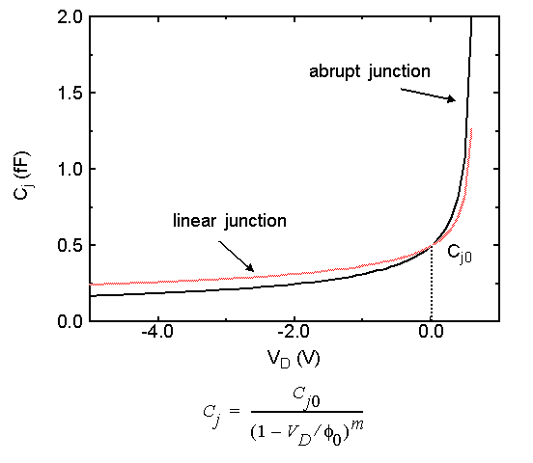
Junction Capacitance
Notes:
plot from book

Slide 14
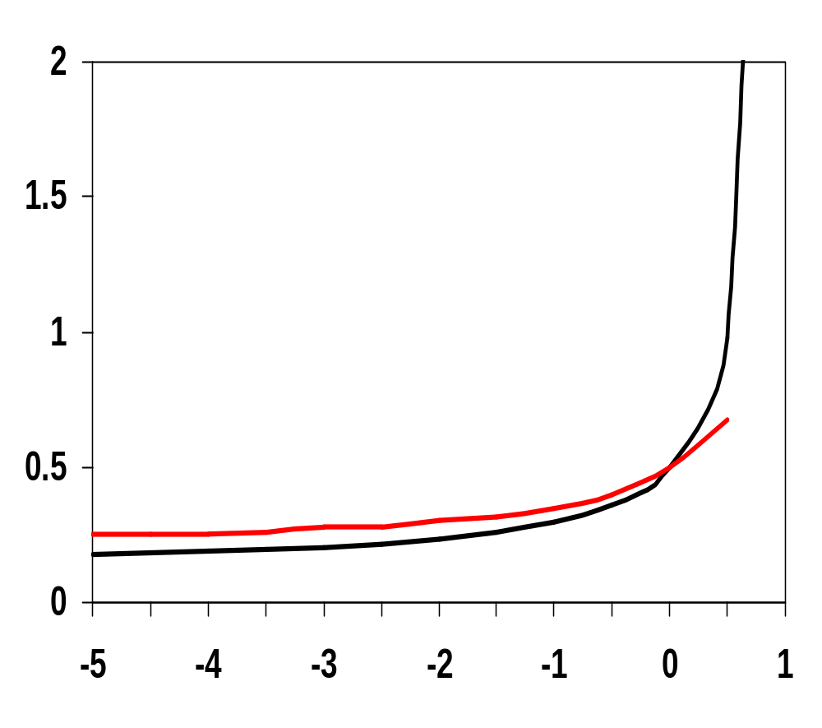
Reverse-Bias Diode Junction Capacitance
abrupt (m=1/2)
C_{j} (fF)
linear (m=1/3)
C_{j0}
V_{D} (V)

Slide 15
MOS Capacitance Model
C_{GS} = C_{GCS} + C_{GSO}
G
C_{GD} = C_{GCD} + C_{GDO}
C_{GS}
C_{GD}
S
D
C_{SB}
C_{GB}
C_{DB}
C_{SB} = C_{Sdiff}
B
C_{DB} = C_{Ddiff}
C_{GB} = C_{GCB}
Notes:
STRUCTURE CAP – CGSO and CGDO – linear
CHANNEL CAPACITANCE – CGCS, CGCB, and CGCD – nonlinear, distributed across the three depending on the operating region
JUNCTION CAPACITANCE – CSdiff and Cddiff – from the bottom and sidewall source and drain to base (depletion region as insulator)

Slide 16
Transistor Capacitance Values for 0.25μ
Example: For an NMOS with L = 0.24 μm, W = 0.36 μm, L_{D} = L_{S} = 0.625 μm
C_{GSO} = C_{GDO} = C_{ox} x_{d} W = C_{o} W =
C_{GC} = C_{ox} WL =
so C_{gate_cap} = C_{ox}WL + 2C_{o}W =
C_{bp} = C_{j} L_{S} W =
C_{sw} = C_{jsw} (2L_{S} + W) =
so C_{diffusion_cap} =
 | C_{ox} (fF/μm²) | C_{o} (fF/μm) | C_{j} (fF/μm²) | m_{j} | φ_{b} (V) | C_{jsw} (fF/μm) | m_{jsw} | φ_{bsw} (V)
NMOS | 6 | 0.31 | 2 | 0.5 | 0.9 | 0.28 | 0.44 | 0.9
PMOS | 6 | 0.27 | 1.9 | 0.48 | 0.9 | 0.22 | 0.32 | 0.9
Notes:
for class handout

Slide 17
Transistor Capacitance Values for 0.25μ
Example: For an NMOS with L = 0.24 μm, W = 0.36 μm, L_{D} = L_{S} = 0.625 μm
C_{GSO} = C_{GDO} = C_{ox} x_{d} W = C_{o} W = 0.11 fF
C_{GC} = C_{ox} WL = 0.52 fF
so C_{gate_cap} = C_{ox}WL + 2C_{o}W = 0.74 fF
C_{bp} = C_{j} L_{S} W = 0.45 fF
C_{sw} = C_{jsw} (2L_{S} + W) = 0.45 fF
so C_{diffusion_cap} = 0.90 fF
 | C_{ox} (fF/μm²) | C_{o} (fF/μm) | C_{j} (fF/μm²) | m_{j} | φ_{b} (V) | C_{jsw} (fF/μm) | m_{jsw} | φ_{bsw} (V)
NMOS | 6 | 0.31 | 2 | 0.5 | 0.9 | 0.28 | 0.44 | 0.9
PMOS | 6 | 0.27 | 1.9 | 0.48 | 0.9 | 0.22 | 0.32 | 0.9
Notes:
For lecture
Diffusion_cap dominates gate_cap – a worst case condition. When the diffusion reverse-bias is increased (the normal operation mode) the diffusion_cap is substantially reduced (see plot on slide 14).
Clever design can reduce LD.
Typically, the diffusion_cap is at most equal to, and often smaller, than the gate_cap.

Slide 18
Review: Sources of Capacitance
V_{out}
V_{in}
V_{out2}
C_{L}
C_{G4}
M₂
M₄
C_{DB2}
C_{GD12}
pdrain
V_{out}
V_{out2}
V_{in}
ndrain
C_{w}
C_{DB1}
M₁
M₃
C_{G3}
intrinsic MOS transistor capacitances
extrinsic MOS transistor (fanout) capacitances
wiring (interconnect) capacitance
Notes:
Parasitic capacitances influencing the transient behavior of the cascaded inverter pair
Cgd1 and Cgd2 are the gate drain capacitances due to overlap in M1 and M2 = 2 CGD0 W
This model assumes M1 and M2 are either cut-off or in saturation (I.e., steady state)
The factor of 2 is due to the Miller effect.
Cdb1 and Cdb2 are the diffusion capacitances due to the reverse-biased pn-junction
Cw is the wiring capacitance (pp, fringe, and interwire) that depends on the length and width of the connecting wire. It is a function of the fanout of the gate and the distance to those gates.
Cg3 and Cg4 are the gate capacitances of the fanout gate that depends, primarily, on the width of those fets - includes both linear overlap and nonlinear gate capacitances

Slide 19
Gate-Drain Capacitance: The Miller Effect
M1 and M2 are either in cut-off or in saturation.
The floating gate-drain capacitor is replaced by a capacitance-to-ground (gate-bulk capacitor).
ΔV
C_{GD1}
V_{out}
V_{out}
ΔV
V_{in}
2C_{GB1}
ΔV
ΔV
M₁
V_{in}
M₁
A capacitor experiencing identical but opposite voltage swings at both its terminals can be replaced by a capacitor to ground whose value is two times the original value
Notes:
The floating gate-drain capacitor must be replaced by a capacitance-to-ground that is accomplished by taking the so-called Miller effect into account.
During a low-high or high-low transition, the terminals of the gate-drain capacitor are moving in opposite directions. The voltage change over the floating capacitor is hence twice the actual output voltage swing.

Slide 20
Drain-Bulk Capacitance: K_{eq}’s (for 2.5 μm)
We can simplify the diffusion capacitance calculations even further by using a K_{eq} to relate the linearized capacitor to the value of the junction capacitance under zero-bias
C_{eq} = K_{eq} C_{j0}
 | high-to-low |  | low-to-high
 | K_{eqbp} | K_{eqsw} | K_{eqbp} | K_{eqsw}
NMOS | 0.57 | 0.61 | 0.79 | 0.81
PMOS | 0.79 | 0.86 | 0.59 | 0.7

Slide 21
Extrinsic (Fan-Out) Capacitance
The extrinsic, or fan-out, capacitance is the total gate capacitance of the loading gates M3 and M4.
C_{fan-out} = C_{gate} (NMOS) + C_{gate} (PMOS)
= (C_{GSOn}+ C_{GDOn}+ W_{n}L_{n}C_{ox}) + (C_{GSOp}+ C_{GDOp}+ W_{p}L_{p}C_{ox})
Simplification of the actual situation
  Assumes all the components of C_{gate} are between V_{out} and GND (or V_{DD})
  Assumes the channel capacitances of the loading gates are constant

Slide 22
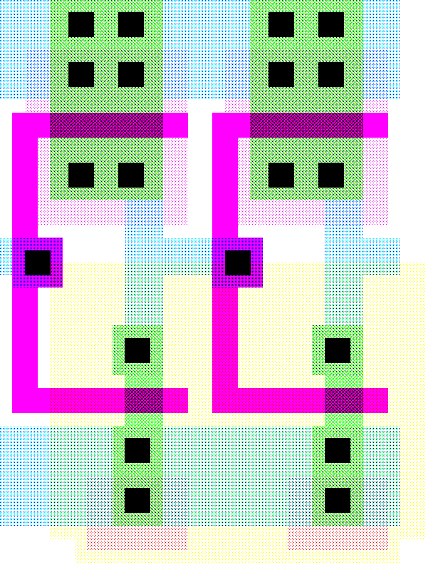
Layout of Two Chained Inverters
V
DD
PMOS
1.125/0.25
1.2
μ
m
=2λ
Out
In
Metal1
Polysilicon
0.125
0.5
NMOS
0.375/0.25
GND
 | W/L | AD (μm²) | PD (μm) | AS (μm²) | PS (μm)
NMOS | 0.375/0.25 | 0.3 | 1.875 | 0.3 | 1.875
PMOS | 1.125/0.25 | 0.7 | 2.375 | 0.7 | 2.375
Notes:
See new book, Chapter 5 for inverter transistor data if interested
Overlap capacitance
CGDO0n = 0.31 fF/um; CGDOp = 0.27 fF/um
Bottom junction capacitance
Cjn = 2 fF/um**2; Cjp = 1.9 fF/um**2
Side-wall junction capacitance
CJSWn = 0.28 fF/um; CJSWp = 0.22 fF/um
Gate capacitance
Cox = 6 fF/um**2

Slide 23
Components of C_{L} (0.25 μm)
C Term | Expression | Value (fF) H→L | Value (fF) L→H
C_{GD1} | 2 C_{on} W_{n} | 0.23 | 0.23
C_{GD2} | 2 C_{op} W_{p} | 0.61 | 0.61
C_{DB1} | K_{eqbpn}AD_{n}C_{j} + K_{eqswn}PD_{n}C_{jsw} | 0.66 | 0.90
C_{DB2} | K_{eqbpp}AD_{p}C_{j} + K_{eqswp}PD_{p}C_{jsw} | 1.5 | 1.15
C_{G3} | (2 C_{on})W_{n} + C_{ox}W_{n}L_{n} | 0.76 | 0.76
C_{G4} | (2 C_{op})W_{p} + C_{ox}W_{p}L_{p} | 2.28 | 2.28
C_{w} | from extraction | 0.12 | 0.12
C_{L} | ∑ | 6.1 | 6.0
Notes:
Red shows values that the designer has control over!
Notice that the load capacitance is almost evenly split between its two major components: the intrinsic capacitance (green) composed of the diffusion and overlap capacitances and the extrinsic capacitance (blue) and wiring capacitances (red) contributed by the connecting gate and wire

Slide 24
Wiring Capacitance
The wiring capacitance depends upon the length and width of the connecting wires and is a function of the fan-out from the driving gate and the number of fan-out gates.
Wiring capacitance is growing in importance with the scaling of technology.

Slide 25
Parallel Plate Wiring Capacitance
current flow
L
electrical field lines
W
H
t_{di}
dielectric (SiO₂)
substrate
permittivity
constant
(SiO₂= 3.9)
C_{pp} = (ε_{di}/t_{di}) WL
Notes:
Parallel plate model – the capacitance is proportional to the overlap between the conductors and inversely proportional to their separation.
Scaling technology shrinks W (L depends on circuit interconnect lengths) but scaling down H at the same time would negatively affect resistance. Thus, H is not scaled by the same ratio as W leading to a smaller W/H ratio (now approaching unity!)

Slide 26
Permittivity Values of Some Dielectrics
Material | ε_{di}
Free space | 1
Teflon AF | 2.1
Aromatic thermosets (SiLK) | 2.6 – 2.8
Polyimides (organic) | 3.1 – 3.4
Fluorosilicate glass (FSG) | 3.2 – 4.0
Silicon dioxide | 3.9 – 4.5
Glass epoxy (PCBs) | 5
Silicon nitride | 7.5
Alumina (package) | 9.5
Silicon | 11.7
Notes:
But the capacitance of a wire is a function of its shape, its environment, its distance to the substrate, and the distance to the surrounding wires, so also have to consider . . .

Slide 27
Sources of Interwire Capacitance
C_{wire} = C_{pp} + C_{fringe} + C_{interwire}
= (ε_{di}/t_{di})WL
+ (2πε_{di})/log(t_{di}/H)
+ (ε_{di}/t_{di})HL
fringe
interwire
pp
Notes:
Cfringe ~ ½ Cpp for 0.5 micron technology
Interwire capacitance is responsible for cross-talk
When W < 1.75 H the interwire capacitance starts to dominate

Slide 28
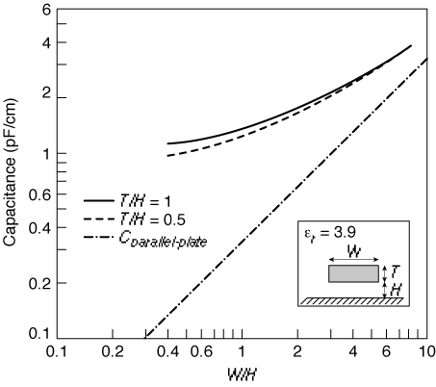

Impact of Fringe Capacitance
H/t_{di} = 1
H/t_{di} = 0.5
C_{pp}
W/t_{di}
Notes:
Assume SiO2 dielectric with relative permittivity of 3.9
For larger values of W/H (smaller values of H/tdi) the total capacitance approaches the parallel-plate model.
Note that the cap level levels off to a constant value of approx. 1 pF/cm for line widths smaller than the insulator thickness (i.e., is no longer a function of the width)

Slide 29
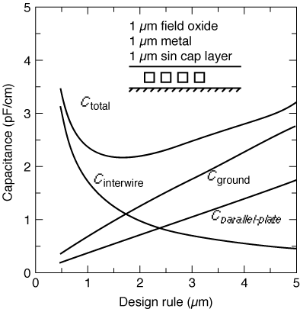
Impact of Interwire Capacitance
Notes:
When W < 1.75H interwire capacitance starts to dominate
Rules of thumb
Never run wires in diffusion
Use poly only for short runs
Shorter wires – lower R and C
Thinner wires – lower C but higher R
Wire delay nearly proportional to L**2

Slide 30
Insights
For W/H < 1.5, the fringe component dominates the parallel-plate component. Fringing capacitance can increase the overall capacitance by a factor of 10 or more.
When W < 1.75H interwire capacitance starts to dominate
Interwire capacitance is more pronounced for wires in the higher interconnect layers (further from the substrate)
Rules of thumb
  Never run wires in diffusion
  Use poly only for short runs
  Shorter wires – lower R and C
  Thinner wires – lower C but higher R
Wire delay nearly proportional to L²

Slide 31
Wiring Capacitances
 | Field | Active | Poly | Al1 | Al2 | Al3 | Al4
Poly | 88
 | 54
Al1 | 30 | 41 | 57
 | 40 | 47 | 54
Al2 | 13 | 15 | 17 | 36
 | 25 | 27 | 29 | 45
Al3 | 8.9 | 9.4 | 10 | 15 | 41
 | 18 | 19 | 20 | 27 | 49
Al4 | 6.5 | 6.8 | 7 | 8.9 | 15 | 35
 | 14 | 15 | 15 | 18 | 27 | 45
Al5 | 5.2 | 5.4 | 5.4 | 6.6 | 9.1 | 14 | 38
 | 12 | 12 | 12 | 14 | 19 | 27 | 52
pp in aF/μm²
fringe in aF/μm
 | Poly | Al1 | Al2 | Al3 | Al4 | Al5
Interwire Cap | 40 | 95 | 85 | 85 | 85 | 115
per unit wire length in aF/μm for minimally-spaced wires
Notes:
Values for a typical 0.25 micron CMOS process; Rows are the top plates; columns are the bottom plate
Consider a wire of 10 cm and 1 micron wide routed in Al1 (e.g., a clock line) (over field) then the
pp cap = (0.1 x 10**6 micron **2) x 30 aF/micron**2 = 3pF
fringe cap – 2 x (0.1 x 10**6 micron) x 40 aF/micron = 8pF
Now, if a second wire is routed alongside the first wire with minimum separations
interwire cap = (0.1 x 10**6 micron) x 95 aF/micron = 9.5pF
If the wire were in Al4 (over field), pp = 0.65pF, fringe = 2.8pF, interwire = 8.5pF

Slide 32
Dealing with Capacitance
Low capacitance (low-k) dielectrics (insulators) such as polymide or even air instead of SiO₂
  family of materials that are low-k dielectrics
  must also be suitable thermally and mechanically and
  compatible with (copper) interconnect
Copper interconnect allows wires to be thinner without increasing their resistance, thereby decreasing interwire capacitance
SOI (silicon on insulator) to reduce junction capacitance

Slide 33
Next Time: Dealing with Resistance
MOS structure resistance - R_{on}
Wiring resistance
Contact resistance

Slide 34
Next Lecture and Reminders
Next lecture
  MOS resistance
    Reading assignment – Rabaey, et al, 4.3.2, 4.4.1-4.4.4
Reminders
  Lecture lectures 9+10 will be combined on the 26th
  HW2 due today
  Project specifications dues October 3rd
  HW3 due Oct 10th
  Evening midterm exam scheduled
    Wednesday, October 16th from 8:15 to 10:15pm in 260 Willard
    Only one midterm conflict filed for so far

